Slide 1
MCPS Systemwide Safety Programs Department of Facilities Management
Chemical Inventory, Safety Overview
Science Resource Teachers
July 6, 2016

Slide 2
Systemwide Safety Programs Contacts
Peter Park, Team Leader
Peter_Park@mcpsmd.org
Laurie Lyons, Program Technician
Laurie_E_Lyons@mcpsmd.org
Office: 240-314-1070
Emergencies: 301-370-2141
www.montgomeryschoolsmd.org/departments/facilities/safety/
twitter.com/MCPSSafety

Slide 3
Systemwide Safety Programs Mission
Help establish and maintain a safe, healthful learning and working environment for students, staff, contractors, and visitors.

Slide 4
Systemwide Safety Programs Major Functions
Guidance/direction to facilities, offices, departments
Oversight of student and employee safety programs
Compliance with safety and health regulations
Coordinate safety training
Hazard evaluation, accident investigation

Slide 5
Systemwide Safety Programs About Us
We are experts in the practice of safety/health
identifying, anticipating, evaluating hazards
determining feasible methods for controlling hazards
We are not experts on what you do (>520 MCPS job titles)
we are not welders, teachers, principals, HVAC mechanics, bus drivers, building service workers, physical therapists, etc.
We must work with you to ensure effective, feasible safety/health procedures and control methods
We are busy, not rude (usually)

Slide 6
Hierarchy of Hazard Controls
A concept used to protect workers from job hazards:
Ranks control method categories by effectiveness
Promoted/required by OSHA/MOSH

Slide 7
Hierarchy of Controls
In order, by decreasing effectiveness:
Elimination/Substitution
Engineering Controls
Lab hood, exhaust ventilation, safety shield
Administrative Controls/Work Practices
Training, written procedures, housekeeping
Personal Protective Equipment (PPE)
Gloves, goggles, apron, lab coat

Slide 8
Hierarchy of Controls Why is PPE a last resort (least effective)?
Requires ongoing proper training
Must be properly selected
Must fit correctly
Must be used correctly
Must be used
Must be maintained, cleaned
Can be uncomfortable
Can create other hazards
heat stress, impaired vision/dexterity/hearing/mobility
Use only when more effective controls are not feasible or 100% effective

Slide 9
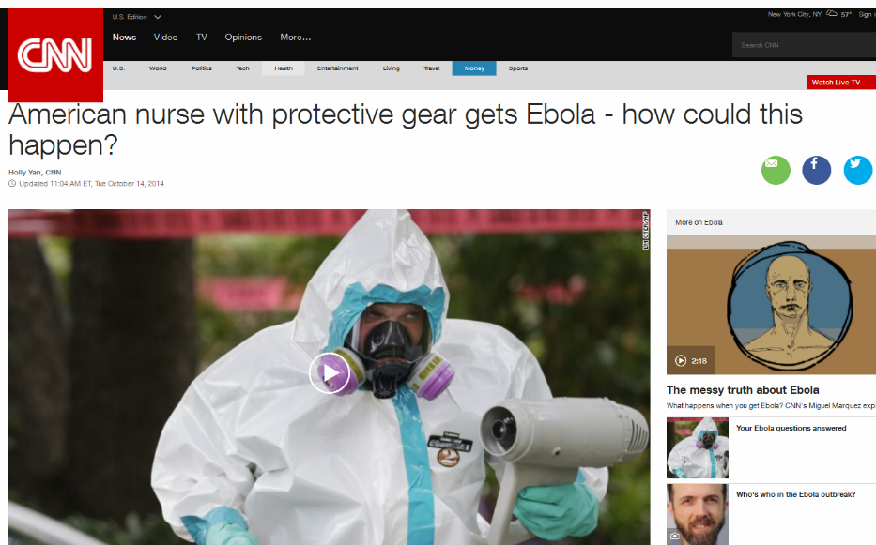
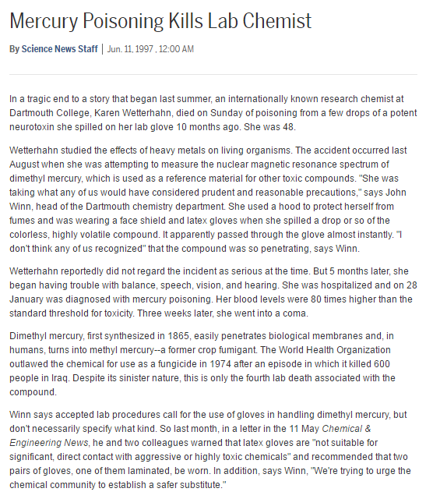
Hierarchy of Controls PPE – Proper Training, Use

Slide 10
Hazardous Chemicals

Slide 11
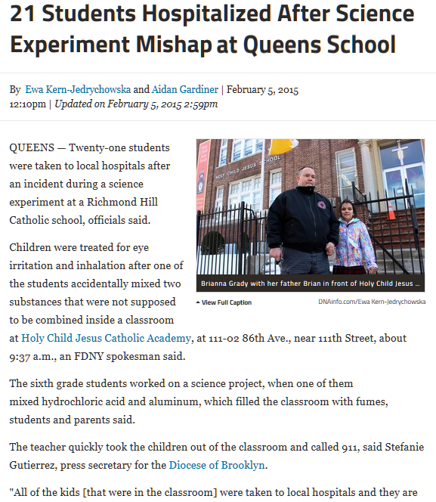
Hazardous Chemicals

Slide 12
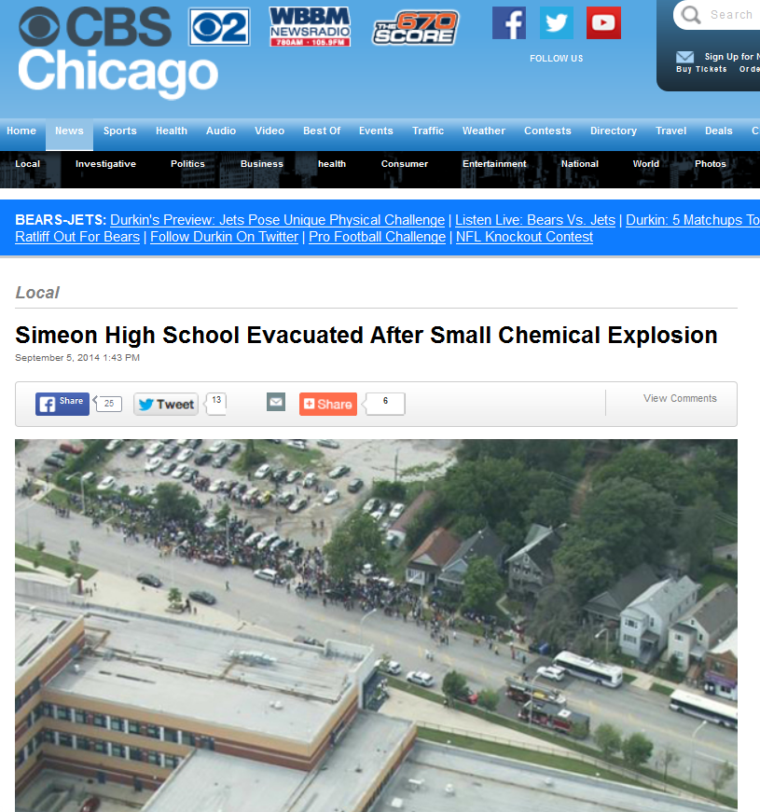
Hazardous Chemicals

Slide 13
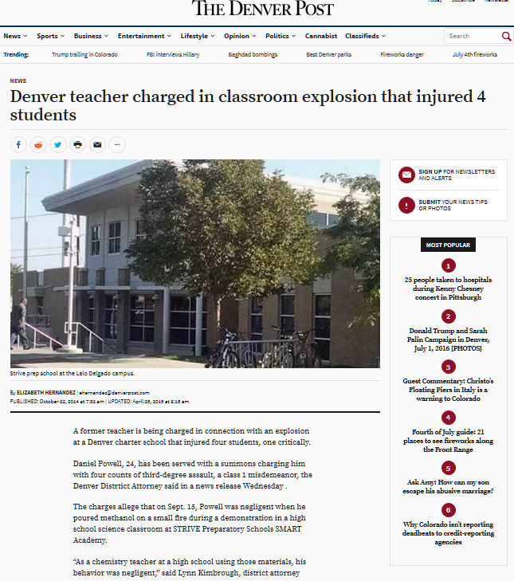
Hazardous Chemicals

Slide 14
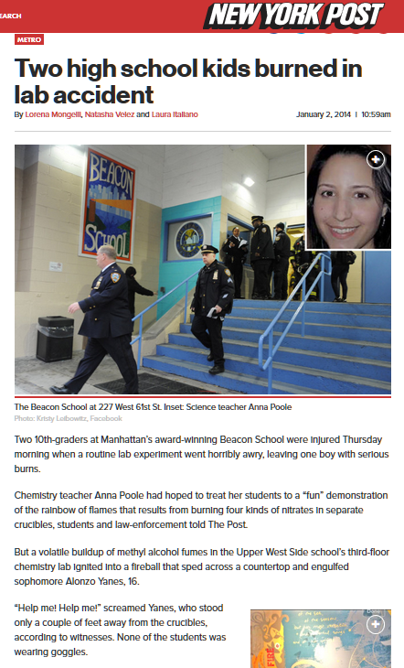
Hazardous Chemicals

Slide 15
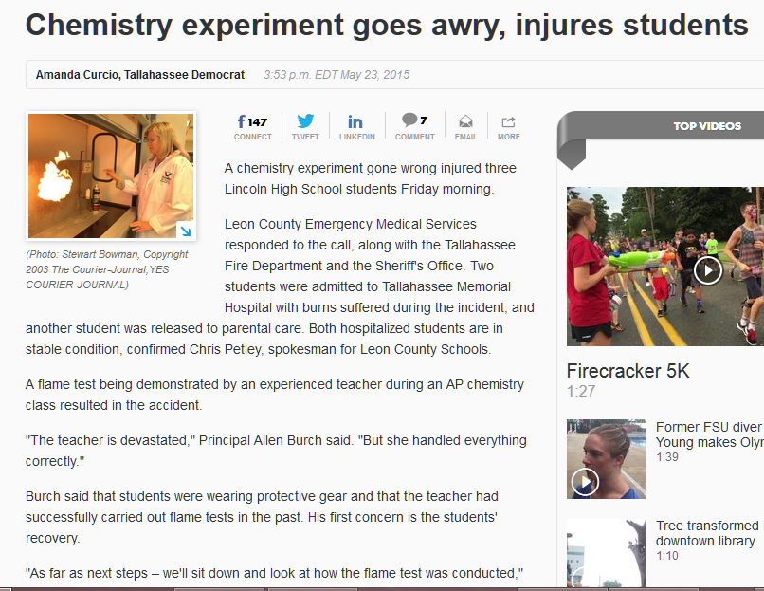
Hazardous Chemicals

Slide 16
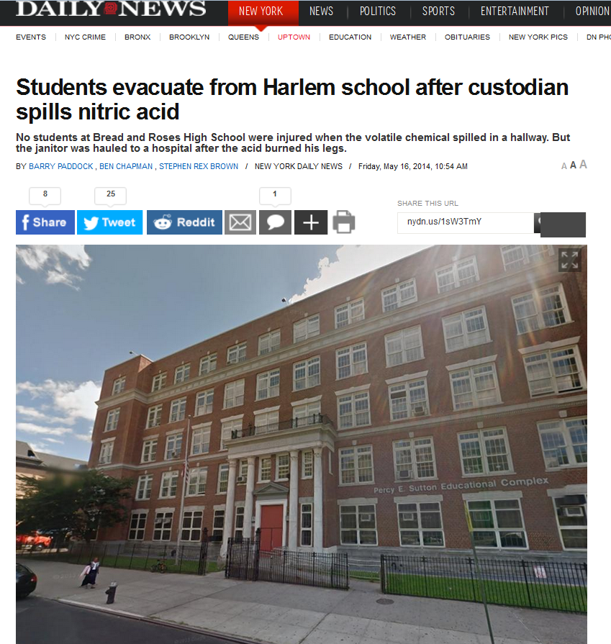
Hazardous Chemicals

Slide 17
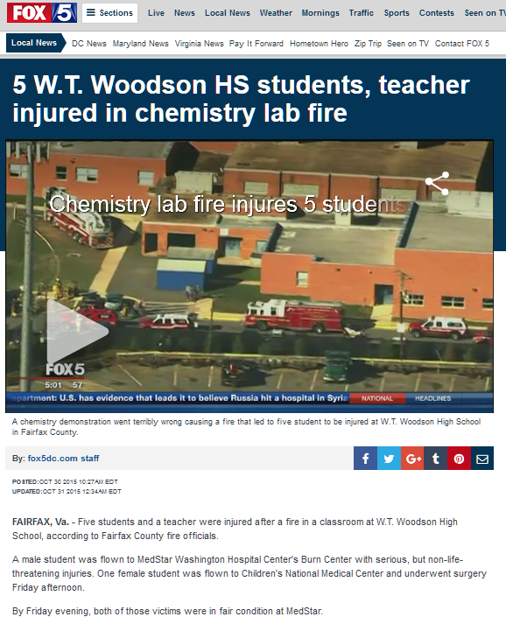
Hazardous Chemicals

Slide 18
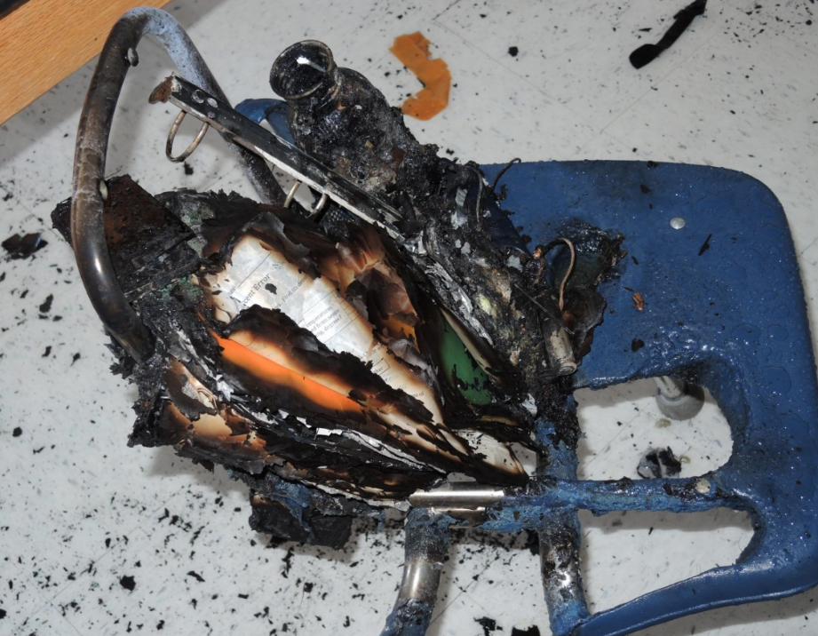
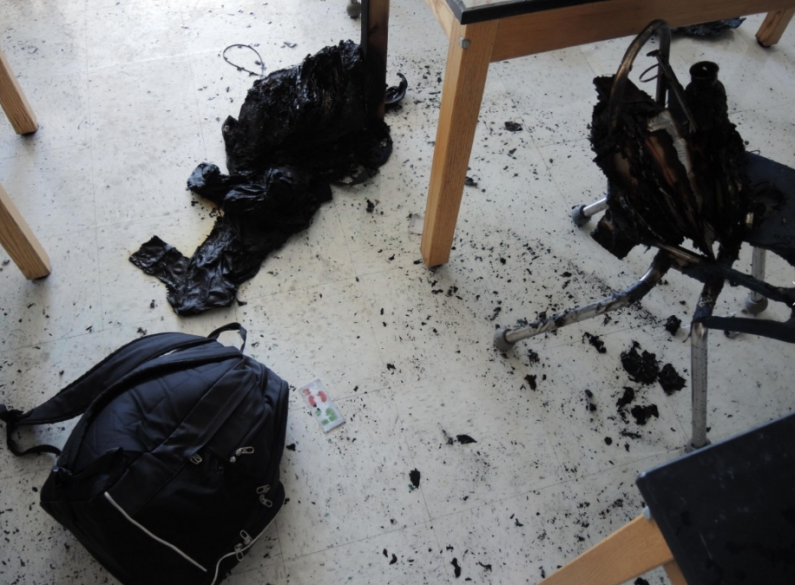
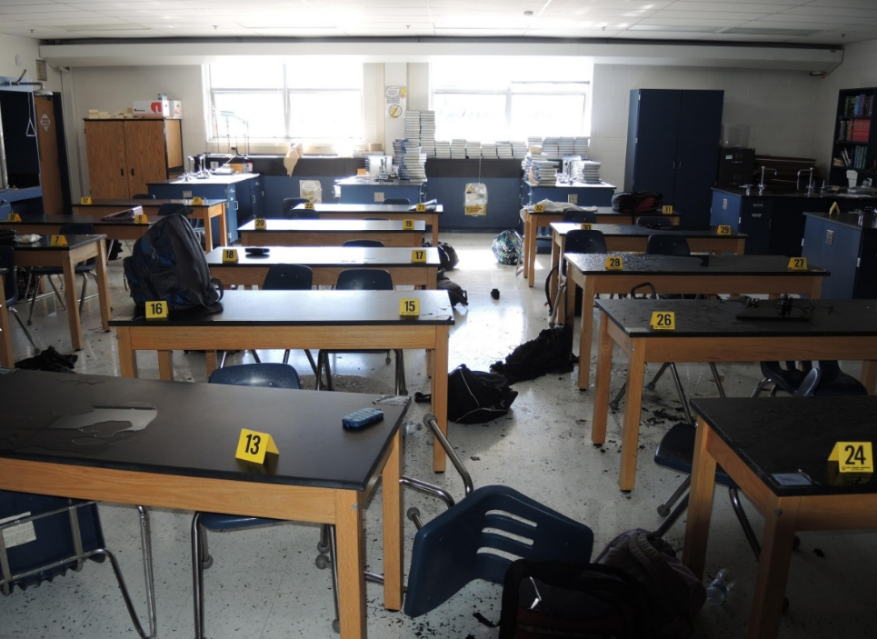
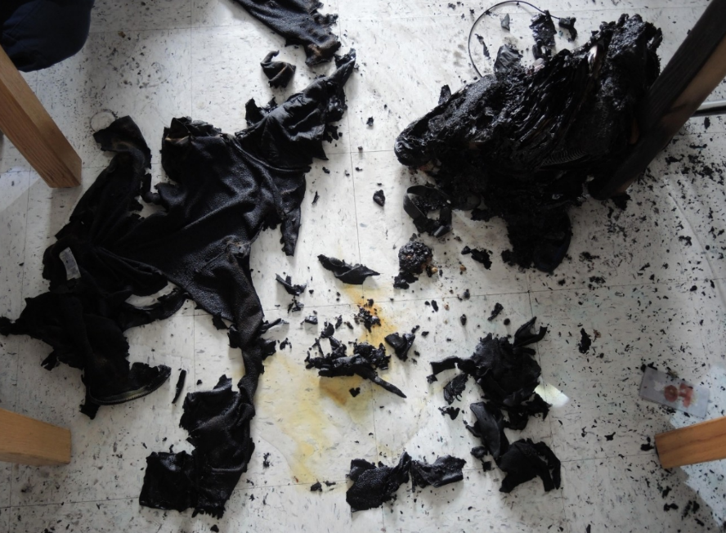
Hazardous Chemicals

Slide 19
Hazardous Chemicals OSHA/MOSH Requirements
Maryland Occupational Safety and Health (MOSH)
Hazard Communication Standard, 29 CFR 1910.1200,
Laboratory Standard, 29 CFR 1910.1450
Complete inventory of hazardous chemicals – Chemical Information List (CIL)
Safety Data Sheet (SDS) for each hazardous chemical
Written Chemical Hygiene Plan (CHP)
Employee training, information, access to CILs and SDSs
Ensure containers labeled, label secondary containers
Maintain each CIL for at least 40 years, most SDSs/MSDSs for at least 30 years
Add new chemicals to CIL within 30 days

Slide 20
Hazardous Chemicals County Requirements
Montgomery County Office of Emergency Management and Homeland Security (OEMHS)
Obtain hazardous materials use permit annually for all facilities
Maintain an alphabetical CIL
Include container types, sizes, amounts on CIL

Slide 21
Hazardous Chemicals Pictograms – see handout
Chemical Type | Pictogram | Description | Examples
Explosives |  | Chemicals susceptible (by heat, shock, friction or other impulse) to a rapid chemical reaction, decomposition or combustion with the rapid generation of heat and gases. | organic peroxides; nitrogen triiodide; picric acid; potassium metal
Flammables |  | Chemicals with the potential to catch fire. Liquids, gases, solids (in the form of dusts) can be flammable and/or explosive. | propane; paint thinner; mastics; solvents (acetone, alcohols, acetic acid, hexane); adhesives (some)
Oxidizers/ Reactives |  | Chemicals that react violently when combined with heat, light water, or atmospheric oxygen, causing explosions or violent chemical reactions. | nitrates; chlorates; nitrites; peroxides; picric acid (crystallized); ethyl ether (crystallized); water reactive metals (e.g., sodium)
Compressed Gases |  | Gases stored under pressure such that cracks or damage to the tanks and valves could cause significant physical harm to those in the same room. | acetylene; helium; nitrogen

Slide 22
Hazardous Chemicals Pictograms
Chemical Type | Pictogram | Description | Examples
Acute Toxics (Severe) |  | Any substance that, even in small amounts, can injure living tissue when ingested, inhaled, or absorbed. | mercury; arsenic; cyanide; mercuric chloride; sodium peroxide
Corrosives |  | Chemicals that can burn, irritate or destroy living tissue or corrode metal through direct chemical action. Includes strong acids and bases (alkaline) and dehydrating agents and oxidants. | sulfuric, nitric, hydrofluoric, and hydrochloric acids; potassium, ammonium, and sodium hydroxides (bases); hydrogen peroxide or chlorine (oxidants)
Chronic Health Hazards |  | Any substance that can cause chronic health effects. Includes carcinogens, mutagens, sensitizers, reproductive toxicants, target organ toxicants. | mercury; arsenic; lead; benzene; cadmium; chromium; PCBs; asbestos; wood dust
Acute Toxics |  | Substances that can cause acute health effects, such as irritation (eye, skin, respiratory), narcotic effects, sensitization. | refrigerants; isocyanates; acetic acid; ammonia; bromine

Slide 23
Labels OSHA/MOSH Requirements
Name of chemical(s)
Hazards (physical and health) – can use pictograms
Manufacturer
Signal Word – Danger, Warning
Precautions

Slide 24
Labels Label Pictograms?

Slide 25
Chemical Information List (CIL) How do you inventory your lab chemicals?
Chemical Inventory Job Hazard Analysis (JHA)
Handout
Download at: http://www.montgomeryschoolsmd.org/uploadedFiles/departments/facilities/safety/JHAScienceChemicalInventory063016FINAL.pdf

Slide 26
PPE – Glove Selection
Nitrile and neoprene or butyl should be sufficient
No glove can protect against all chemicals
Ensure proper fit, use, training
Do not immerse gloved hands in chemicals – gloves are not indestructible
Minimize contact with chemicals
Always wash hands after removing gloves

Slide 27
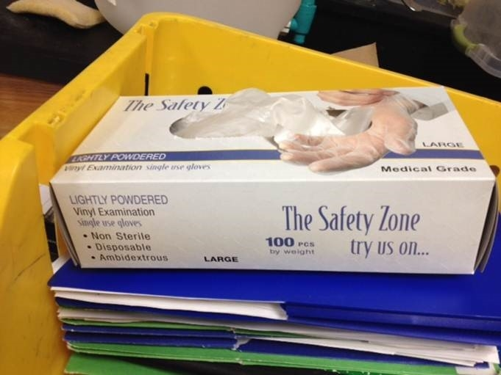
PPE – Glove Selection
No latex, no vinyl medical or food service gloves

Slide 28
PPE - Glove Selection Which material will protect you?
Check for information from:
Safety Data Sheet (SDS)
Chemical-resistant glove selection guides (Flinn - handout)
Glove manufacturer guides
Ansell online guide http://www.ansellpro.com/specware/guide.asp
Ansell downloadable guide www.ansellpro.com/download/Ansell_8thEditionChemicalResistanceGuide.pdf
Showa Best online guide http://www.showagroup.com/innovation/chemical-resistance

Slide 29
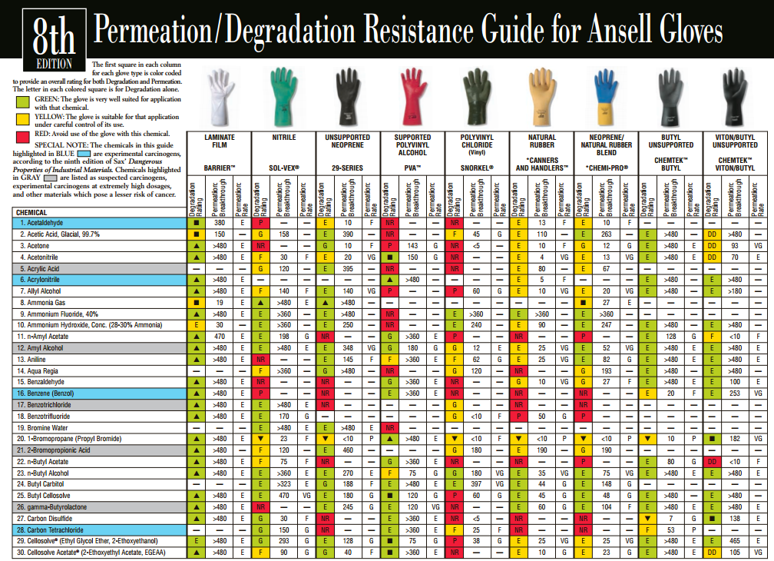
Glove Selection
Ansell Guide: http://www.ansellpro.com/download/Ansell_8thEditionChemicalResistanceGuide.pdf

Slide 30
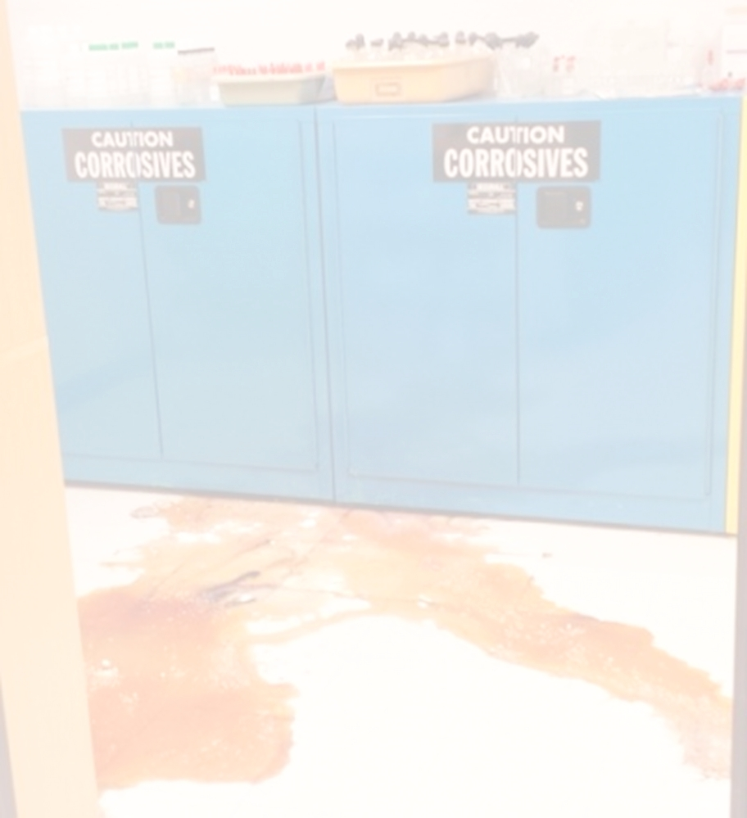
Hazardous Chemicals What if you have a large chemical (or any mercury) spill?
Evacuate, isolate the room or immediate area
Call 911 if severe, or immediate help needed
Provide first aid, as needed
Open windows and turn off HVAC, if feasible
Contact SSP (240-314-1070; 301-370-2141) or ES/IAQ (301-926-4409) immediately
Sequester potentially contaminated materials and occupants in nearby hall or room, if possible
Implement Shelter In Place, if needed
Do not attempt to clean the spill

Slide 31
Online Safety Training
Mandatory online safety training for secondary science staff:
Bloodborne Pathogen Exposure Prevention – Annually
Science Lab Safety – Annually
Hazard Communication: Right to Understand
Safety Data Sheets: Globally Harmonized System (GHS)
New Process (no more PDO registration, PDO transcript):*
Go to SafeSchools at mcps.md.safeschools.com/login
Log on using your Outlook user name; no password is needed
The training home page will list mandatory and suggested (voluntary) training courses
Click any course name to begin training
Print a certificate of completion after completing each course
* Directions to take courses, view course completion records, and print/save certificates: http://www.montgomeryschoolsmd.org/departments/facilities/safety/training.aspx

Slide 32
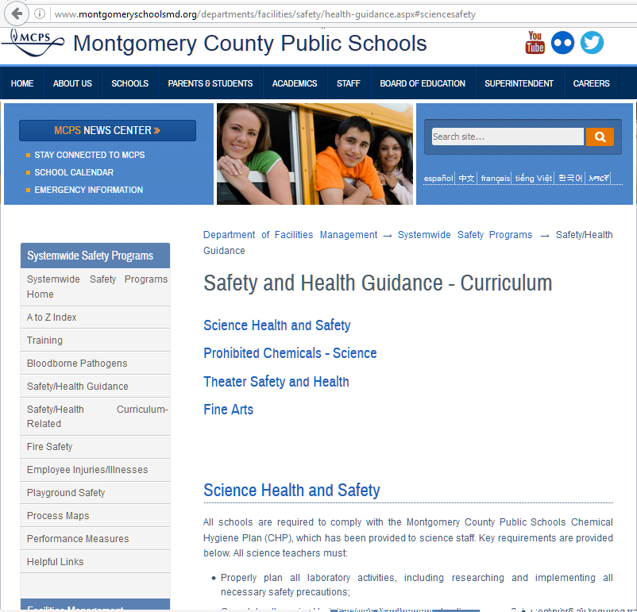
Systemwide Safety Programs Science Safety Page – SSP Website
www.montgomeryschoolsmd.org/departments/facilities/safety/health-guidance.aspx

Slide 33
Questions?

