Slide 1


Slide 2
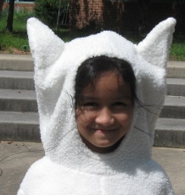
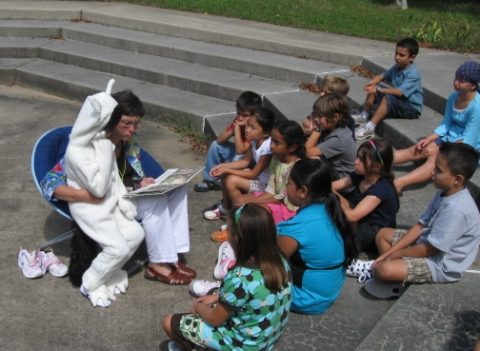
Opening the Door to the Outdoor Classroom
Notes:
2
Slide 1:
Slide Title: Title Page, “Opening the Door to the Outdoor Classroom”
Script: Simply a voiceover of: “Opening the Door to the Outdoor Classroom”
Notes: I have a video clip to play and we can have the title appear over it.
The outdoor environment provides authentic opportunities for students to move from conceptual to real life application.
Film and explanation upfront setting the purpose. Use teacher reflections here.

Slide 3
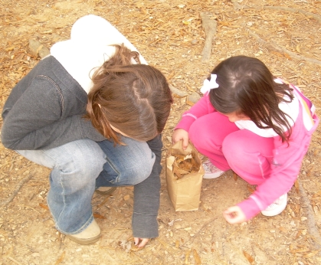
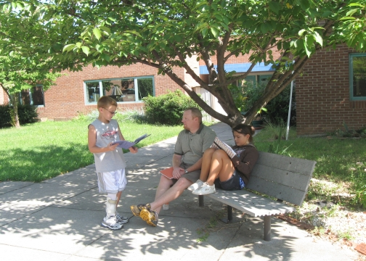
Outcomes:
By the end of this presentation, you will:
Be aware of how your administration and your staff can integrate curriculum content with the No Child Left Inside movement.
Explore how you can access effective and frequent lessons that connect curriculum content outdoors.
Review how to ensure a comfortable and valuable learning experience for you and your students.
Notes:
3
Slide 2:
Slide Title: Outcomes
Script: Will probably include a voice over which will read the outcomes:
“By the end of this professional development product, you will:
be knowledgeable of the No Child Left Inside movement as it grows throughout the nation
be able to create safe, effective lessons that deliver the curriculum content in the outdoors on a regular basis throughout the school year
be familiar with the safety guidelines and procedures that will ensure a comfortable and valuable learning experience for you and your students
Notes: Do we really want to just read what is already up on the screen?
Think about putting video of teaching outdoors upfront then asking how did the class get to this point.

Slide 4
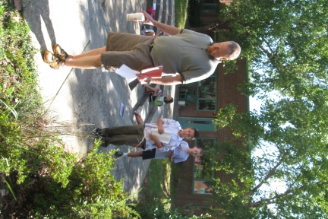
Benefits of Using the Outdoors for Learning:
increased attendance
increased physical activity
reduced ADHD symptoms
decreased disciplinary referrals
increased authentic experiences
increased student achievement
increased teacher job satisfaction
increased success for all students
Notes:
4
Slide 4
Slide Title: Benefits of Teaching Outdoors in the Schoolyard and Neighborhood:
Script:
Research shows there are important benefits associated with teaching outdoors such as providing a wealth of real-life opportunities to apply and extend classroom learning.
Outdoor hands-on learning tends to “Level the playing field” for all students. Such authentic experiences are remembered and students are engaged.
Lee/Keith to add data

Slide 5


No Child Left Inside Act of 2009
http://www.cbf.org/Page.aspx?pid=687
Governor O’Malley’s Executive Order
http://www.dnr.state.md.us/education/children_nature/
Notes:
Remake of Slide #3
SCRIPT:
No Child Left Inside is a national movement to advance environmental education in schools promoting hands-on instruction to help students learn about the world around them, a world they will inherit.
The No Child Left Inside Act of 2009 is national legislation introduced by Senator Jack Reed (Democrat from Rhode Island) and Congressman John Sarbanes (Democrat from Maryland) to advance environmental education in our nation’s schools.
In our own state, Governor O’Malley issued an Executive Order to establish the Maryland Partnership for Children in Nature, which promotes environmental awareness through formal and informal experiences.
At the local level, MCPS is supporting teaching and learning in outdoor environments to enhance student achievement across the content areas and uses the title, “Teaching and Learning Through Environmental Awareness” on its 2009-2010 Comprehensive Calendar.

Slide 6


Maryland No Child Left Inside
http://www.cbf.org/Page.aspx?pid=757
Environmental Literacy
Graduation Requirement
http://www.dsd.state.md.us/comar/comarhtml/13a/13a.04.17.01.htm

Slide 7

Research Shows:
A positive, statistically significant relationship between schools with the Maryland Green School* designation and higher reading and math achievement on the Maryland School Assessments.
*Maryland Green Schools are those schools who have applied for and received certification through the Maryland Association of Environmental and Outdoor Educators (MAEOE).
A sampling of green schools…
Notes:
7
Slide 5
Slide Title: Research Shows:
Script:
After controlling for socioeconomic variables and the percent of students receiving special education services, a 2004 study sponsored by MAEOE, found that a positive, statistically significant relationship was found between schools with the Maryland Green School designation and higher reading and math achievement on the Maryland State Assessments.

Slide 8
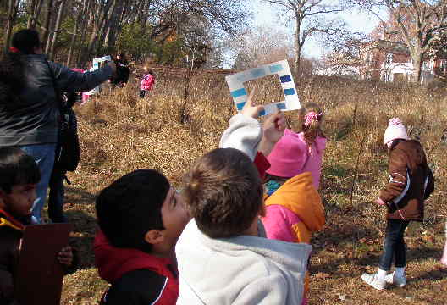
Research Also Shows:
American children, on average, are spending only 30 minutes of unstructured time outdoors each week.
So wouldn’t it be great if we could get them outside more often AND make learning more meaningful?
Notes:
8
Slide 6
Slide Title: Research Also Shows:
Script:
Research Also Shows:
Outdoor play and nature experience have proven beneficial for cognitive functioning, reduction in symptoms of Attention Deficit Disorder (ADD), and an increase in self-discipline and emotional well being at all developmental stages. But American children, on average, are spending only 30 minutes of unstructured time outdoors each week.
Last Child in the Woods --

Slide 9

Want to learn more?
Go to the MAEOE “Benefits of Environmental Education” page…there’s enough data there to convince anyone!
http://www.maeoe.org/resources/research/

Slide 10
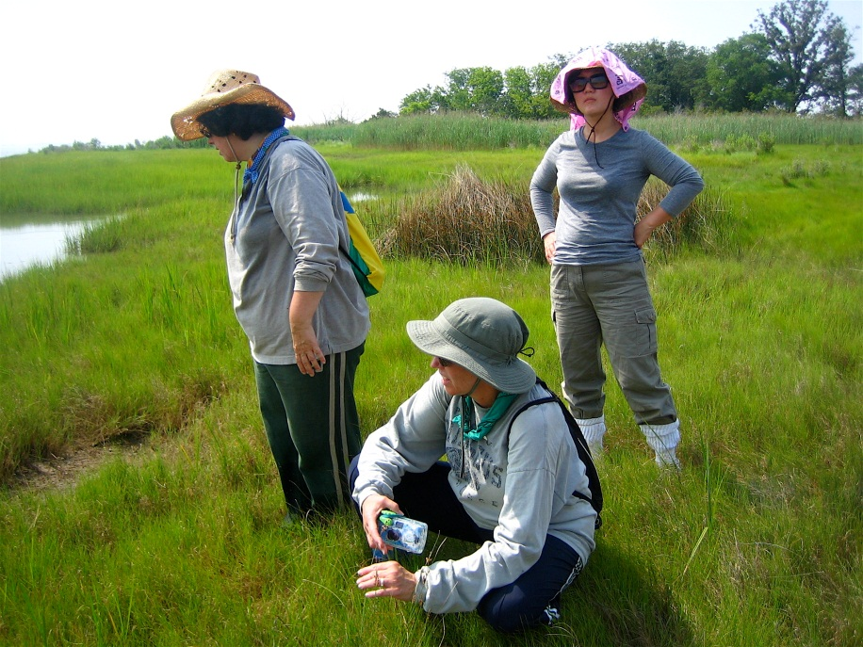
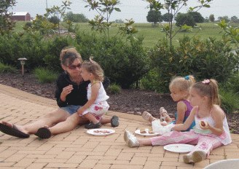
We can get these results too, by:
Using our resources
Training our staff (Professional Development; CBF; Professional Days, etc.)
Creating partnerships (Audubon Society; Environmental Education Centers; Community Supported Agricultural Centers, etc.)
Looking for logical connections (it’s not JUST science…)
Notes:
10
Slide 25
Slide Title: In Conclusion
Script: As each bulleted item appear, a voiceover of the question.
What are some ways you need to prepare for using the outdoor environment as an extension to classroom instruction?
What resources do you already have?
What additional resources do you need?
How might you be able to promote environmental education in your school?
Notes:

Slide 11
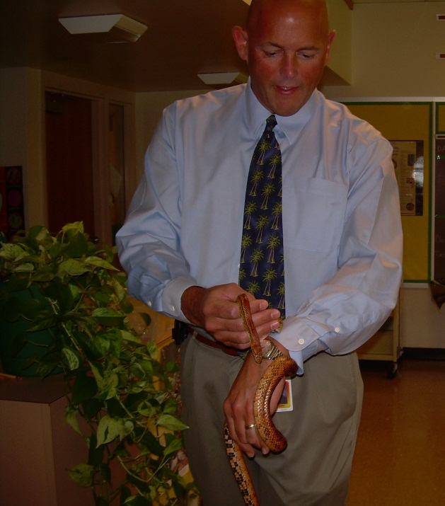
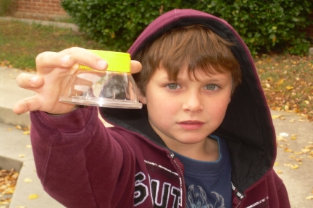
Foster Positive Attitudes…
Let's
Replace “outdoor activity” with “field experience” or “field work.”
Refer to the students as “scientists, botanists” or “zoologists.”
Replace “eeewww” or “gross” with “interesting” or “cool” or “I wonder…” or “I think...”
Notes:
11
Slide 20
Slide Title: Fostering positive attitudes
Script: Narrator reads whole slide, then adds:
Just like indoors, modeling appropriate vocabulary, a
positive attitude and respect for the outdoors
as a place for learning is important.
Kids are very impressionable by the adults around them. Impressions are formed early and tend to reflect the attitude of the adults.

Slide 12
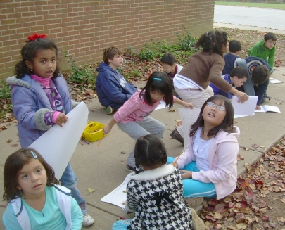
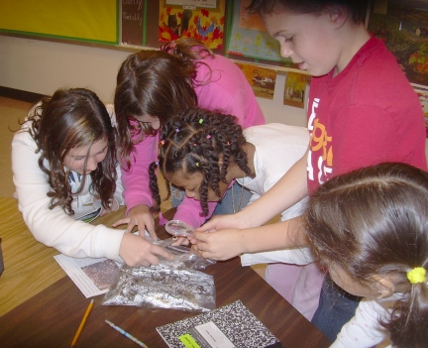
Use Best Practices for Teachers…
Let's
Integrate Learning
Make connections
Brainstorm inquiry topics
Encourage questions!
Notes:
12
Slide 21
Slide Title: Best Practices for Teachers in an Outdoor Classroom
Script: Have each bullet appear one at a time and read each one as it appears.
Read the entire slide.
Too much print!

Slide 13
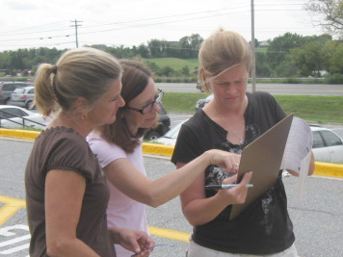
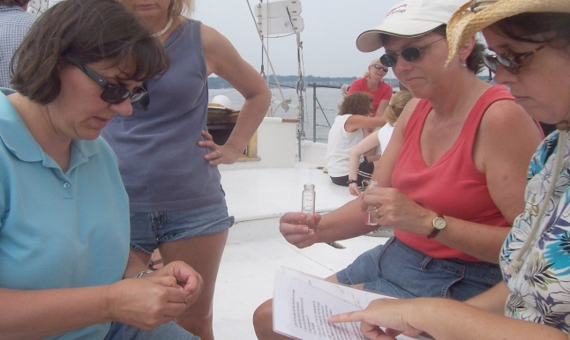
…Create professional learning communities for teachers.
Let's
Collaborate with colleagues.
Keep up on local environmental issues!
Investigate the Maryland Green Kids/Green School certification process.
Take advantage of professional development opportunities.
Notes:
13
Slide 22
Slide Title: Creating Professional Learning Communities for Teachers using the Outdoors as a Classroom
Script:
Teachers make it happen!
A Green School application documents how the school uses the environment as a place to learn.
For teachers, it’s not teaching additional lessons….it is about HOW you teach what you teach!

Slide 14
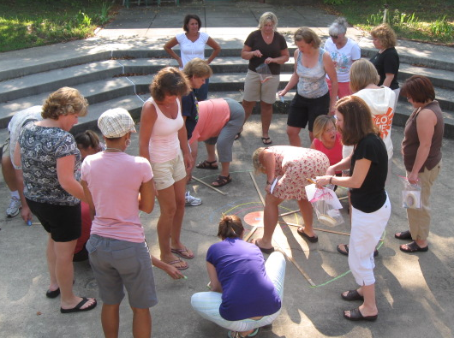
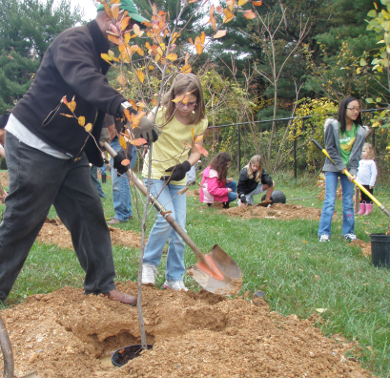
Some ways to create those professional learning opportunities…
Courses
(get the grown-ups outside, too!)
Conferences
Partnerships

Slide 15
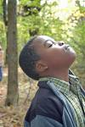
Here’s how professional development can translate to your school:
Using EE-02 Teaching Techniques for Outdoor Education “Get Kids Outside”
For example...
Claire Gardner
5-12-09

Slide 16
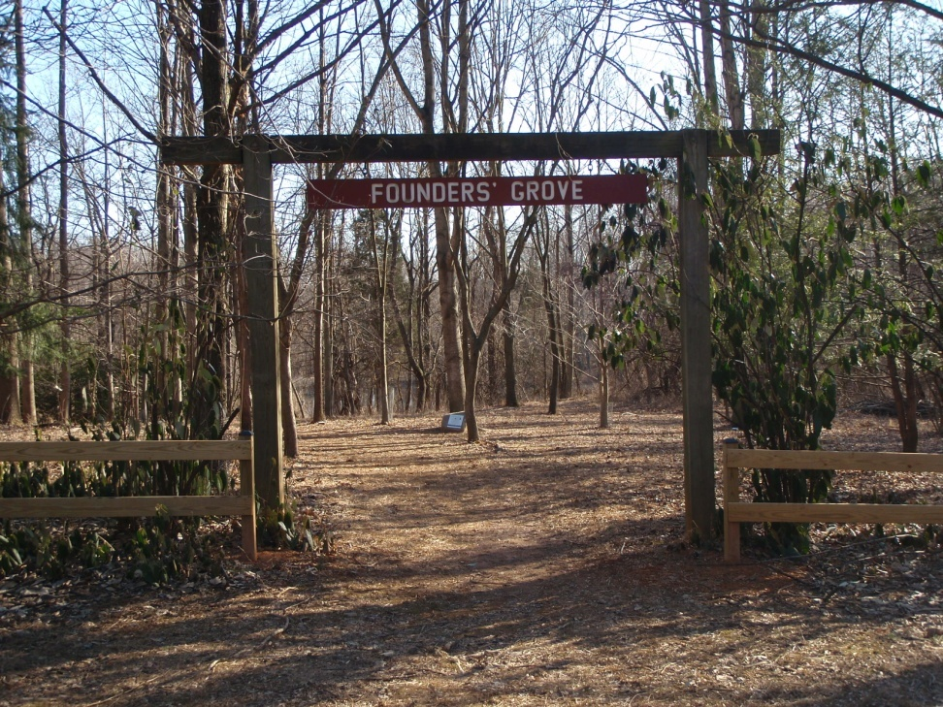
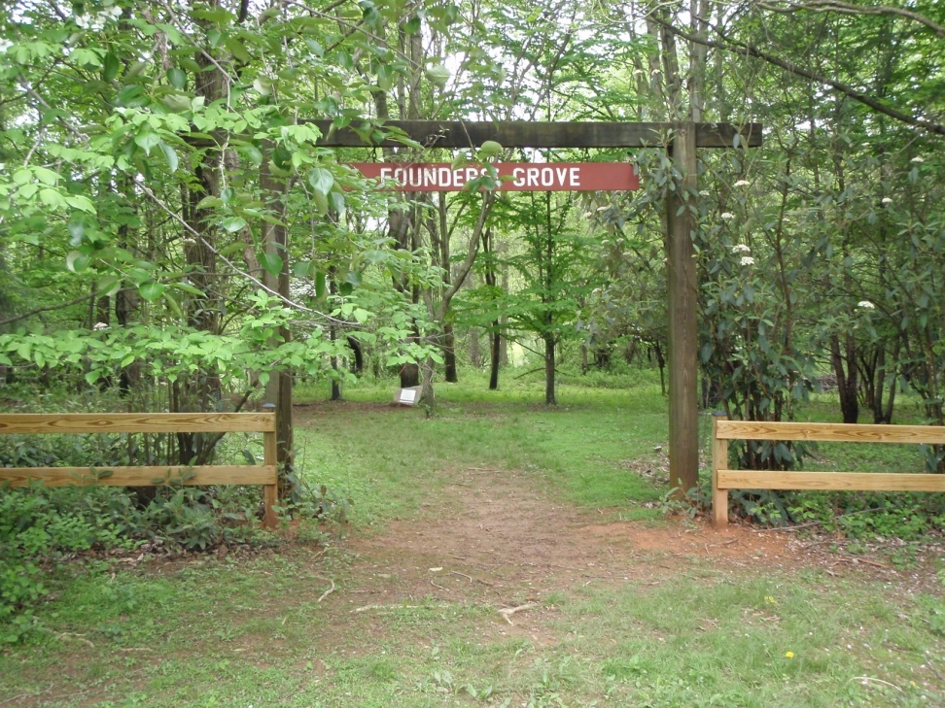
Raising awareness of natural surroundings through the vehicle of journaling.
February 24, 2009
May 5, 2009

Slide 17
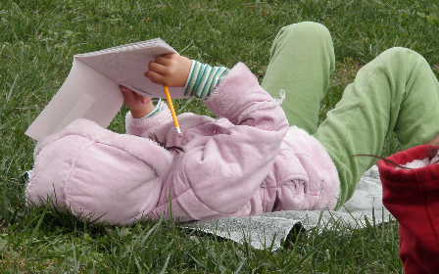
Students will be able to:
Construct knowledge.
Apply evidence and reasoning.
Communicate scientific information.
Create opportunity to ensure the development
of environmental literacy.
Strengthen their connection to nature
during the school day.
Notes:
17

Slide 18
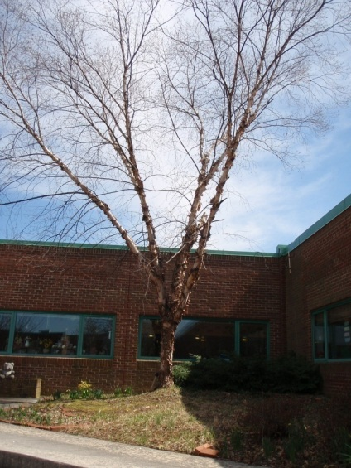
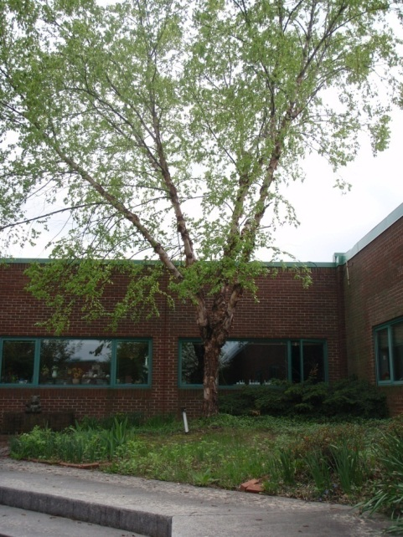
How you can do this:
Choose a time period that will cover seasonal changes.
Choose a location that will provide many sensory experiences.
Determine how much information you want the students to ‘discover’ (how soon are you willing to share the informational texts).
Determine how often to visit the location.
Choose appropriate informational texts.
Be a good model: record in your own journal.

Slide 19
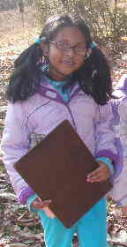
Insights into student learning:
Students are not accustomed to having ‘free writing’: “can we…”; “do we…”; “are we allowed to…”
Students test new information based on their past knowledge and experiences (“Is that algae?” referring to moss).
Students realize the potential (“Hey, this is science AND math!”)
“When can we go to see our tree again?”
Notes:
19

Slide 20
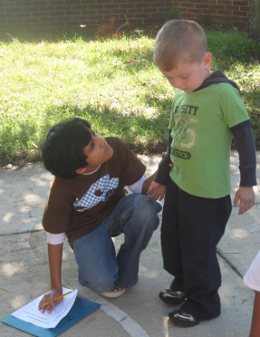
Almost anything you can do inside the classroom, can be done outside…
Journal based on observations (even using poetry)!
Compare types of motion – variable, uniform, and periodic!
Measure tracings!
Create patterns with natural objects!
List different construction materials!
Find and measure wind speed with our anemometer!
Collect signs of Fall!
Classify leaves!

Slide 21
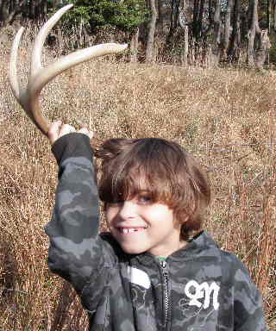
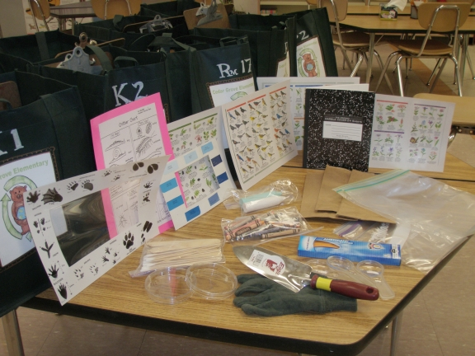
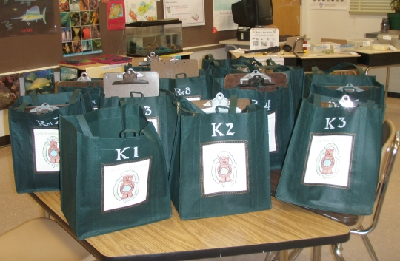
You can do this, using all your resources:
  Your Content Curriculum
  Your school grounds
  Your science supplies
  In school and out of school field trips
Notes:
21
Slide 25
Slide Title: In Conclusion
Script: As each bulleted item appear, a voiceover of the question.
What are some ways you need to prepare for using the outdoor environment as an extension to classroom instruction?
What resources do you already have?
What additional resources do you need?
How might you be able to promote environmental education in your school?
Notes:

Slide 22
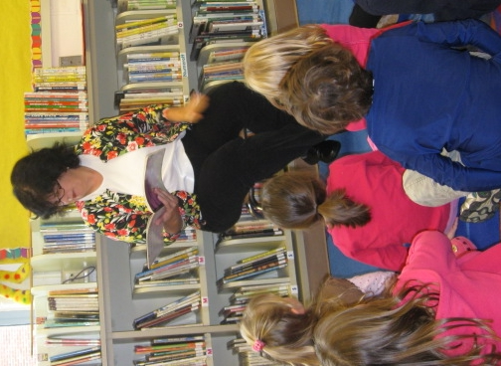
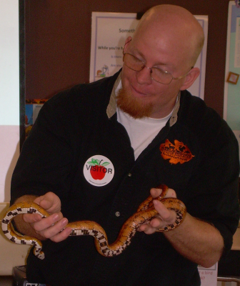
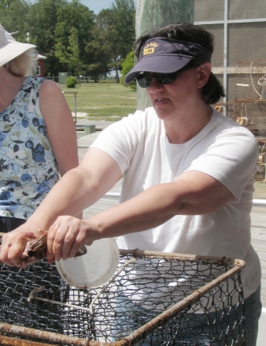
And yet more resources:
  The media center
  Experts from our community
  Community Partnerships

Slide 23
Why is this time well spent?
We are ensuring environmental literacy.
We are strengthening student’s connection to nature during the school day.
How could it NOT be time well spent?
Notes:
23

Slide 24
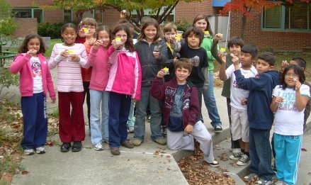
What can you do at your school so that no child is left inside…?

