Slide 1
Financial Aid

Slide 2
What is Financial Aid?
Financial aid consists of funds provided to students and families to help pay for postsecondary educational expenses.

Slide 3
Sources of Financial Aid
Federal Government
Employers
States
Private Sources
College and Universities

Slide 4
FSA ID
An FSA ID gives you access to Federal Student Aid’s online systems and serve as your legal signature.
Both students and parents need to create one.
Will be used throughout the aid process, including subsequent years.
https://fsaid.ed.gov

Slide 5
Free Application for Federal Student Aid (FAFSA)
MUST be filled to receive federal aid
  Required for some state and institutional as well
A standard federal form that collects demographic and financial information about student and family
May be filed at any time during an academic year, but no earlier than the October 1st prior to the academic year for which the student requests aid

Slide 6
FAFSA: Prior-Prior Year
Starting October 1, 2020, students can begin FAFSA for 2021-22 academic year using prior year info.
  2019 Tax Info

Slide 7
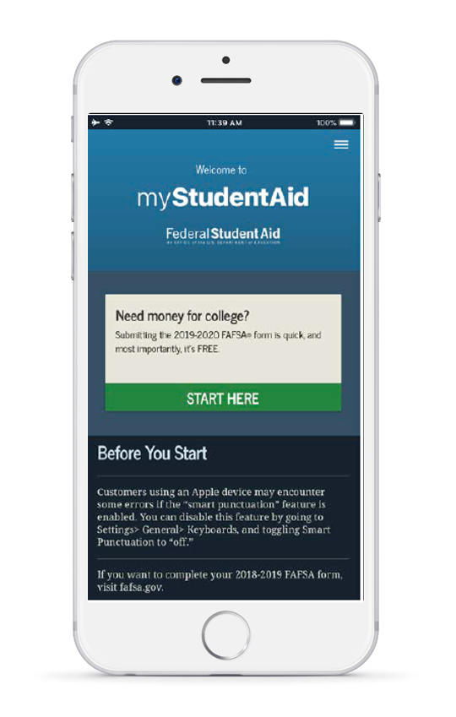

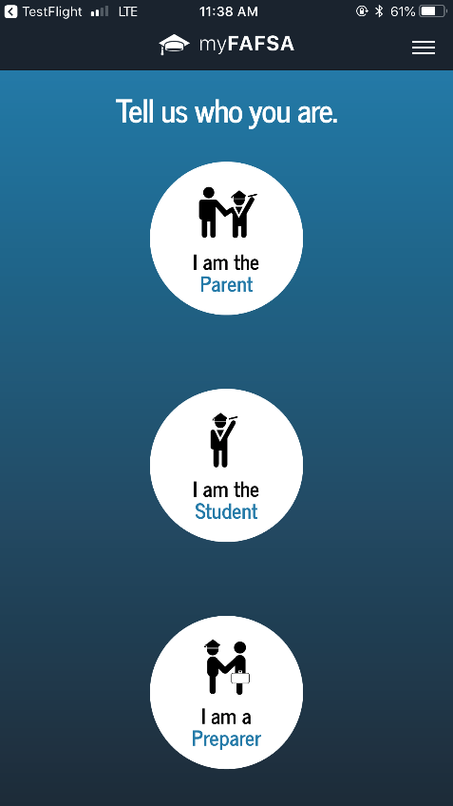
FAFSA can now be completed on an app!

Slide 8
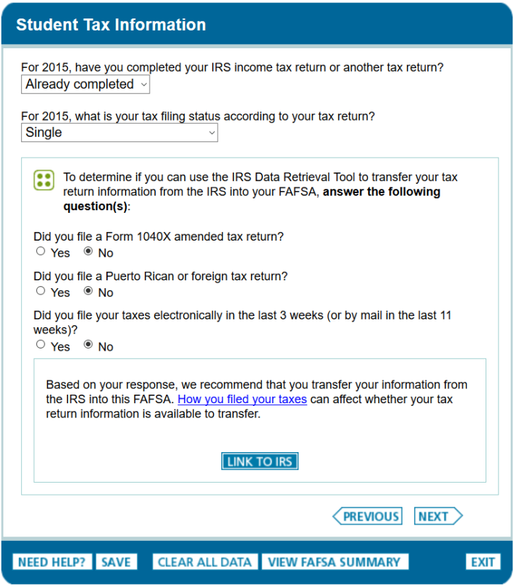
IRS Data Retrieval Tool (IRS DRT)
The IRS Data Retrieval Tool allows students and parents to access the IRS tax return information.
Transfer the data directly into their FAFSA from the IRS Web site.

Slide 9
What is the Expected Family Contribution (EFC)?
Calculated by formula in FAFSA
Stays the same regardless of college
Amount a family can reasonably be expected to contribute per academic year of education

Slide 10
High Impact Information & EFC
Tax Info
  AGI, Taxes, Earnings
Current Financial Info
  Cash/Savings, Investments, Business/Farm income
Number in Household
  Number in College
Untaxed Income

Slide 11
What is Cost of Attendance (COA)?
Direct costs
  Tuition
  Fees
  Room
  Board
Indirect costs
  Books
  Transportation
  Personal Expenses
  Loan Fees
Cost of Attendance

Slide 12
What is Financial Need?
Cost of Attendance
Expected Family Contribution (EFC)
Financial Need

Slide 13
CSS Profile
CollegeBoard Financial reporting
Used to determine need for institutional aid
Uses 2 years of financial data
  Includes private assets in EFC calculation
Fee for initial application and one college report is $25.
  Additional reports are $16.
Used by approx. 400 colleges and scholarship programs
  Only 3 in MD
Notes:
Hopkins University
Loyola University
St. Johns College

Slide 14
Institutional Funding
Scholarships
  Awarded for student achievement regardless of financial need
  Universities will have separate scholarship applications for the different colleges
Grants
  Need based funds offered to assist in covering CoA

Slide 15
State Funding
An only be used for MD schools
Aid is awarded on the basis of both merit and need
FAFSA is required for some
  March 1, 2021
For MD funding check Maryland Higher Education Commission (MHEC) www.mhec.state.md.us
  Legislative Scholarships
    www.mdelect.net

Slide 16
Outside Scholarships
Scholarship search engines
  Fastweb
  Scholarships.com
  Cappex
  Scholly
  Niche
  Scholarship Monkey
Scholarships are everywhere

Slide 17
Loans

Slide 18
Loan Types
Stafford Loans
  Student Loans
    Subsidized
    Unsubsidized
  PLUS Loans (Parent)
Private Source Loans
  Banks
  Credit Unions
  Private Loan Servicer

Slide 19
Subsidized VS. Unsubsidized
Direct Subsidized Loans are available to undergraduate students with financial need.
Your school determines the amount you can borrow, and the amount may not exceed your financial need.
The U.S. Department of Education pays the interest on a Direct Subsidized Loan
  while you’re in school at least half-time,
  for the first six months after you leave school
  during a period of deferment
Direct Unsubsidized Loans are available to undergraduate and graduate students.
Your school determines the amount you can borrow based on your cost of attendance.
You are responsible for paying the interest on a Direct Unsubsidized Loan during all periods.
  If you choose not to pay the interest while you are in school and during grace periods, your interest will accrue and be capitalized

Slide 20
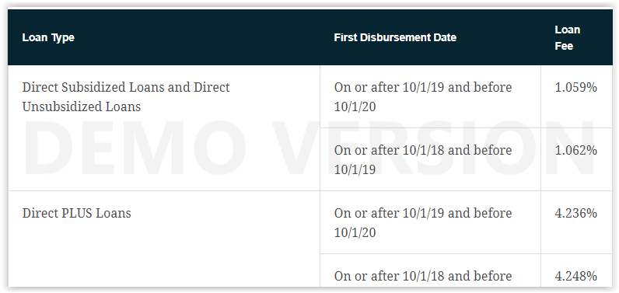
Loan fees change every year.
Example: 1.059%
$5500 loan fees= $58.25
Total amount credited to your account= $5441.75

Slide 21
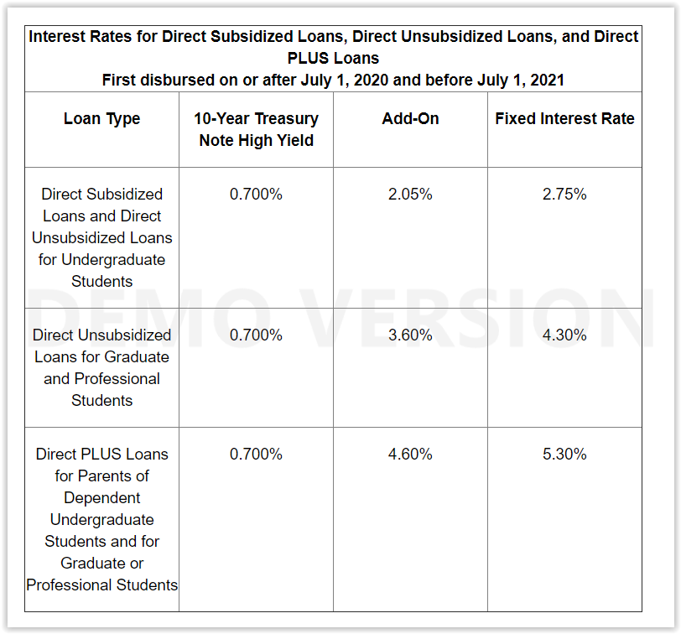
Rates for 2021 and beyond will change annually.
Interest rates are fixed for the life of the loan.

Slide 22
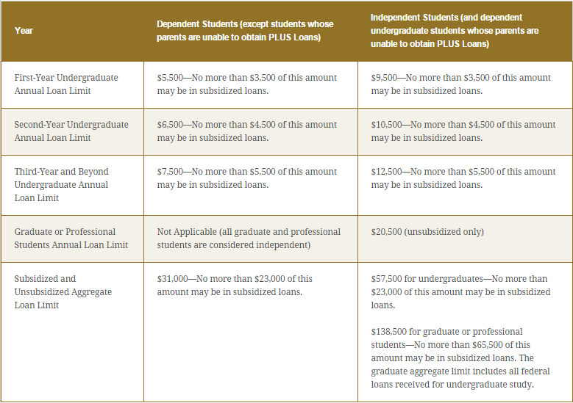

Slide 23
Special Circumstances
Conditions exist that cannot be documented with the FAFSA
Send written explanation and documentation to your college’s financial aid office
College will review and request additional information if necessary

Slide 24

Secondary school tuition
Unusual uncovered medical/dental expenses
Extraordinary dependent care
Parent or spouse death
Loss of employment
Divorce

Slide 25
Financial Aid Packages
Early Decision/Action Applicants
  Financial Aid Packages included in admit packet
Regular Decision Applicants
  Financial Aid Packages included in admit packet
Should include (if eligible)
  Federal Grants
  State Grants
  Institutional Need Based Grants
  Institutional Scholarships
  Federal Loan options

Slide 26
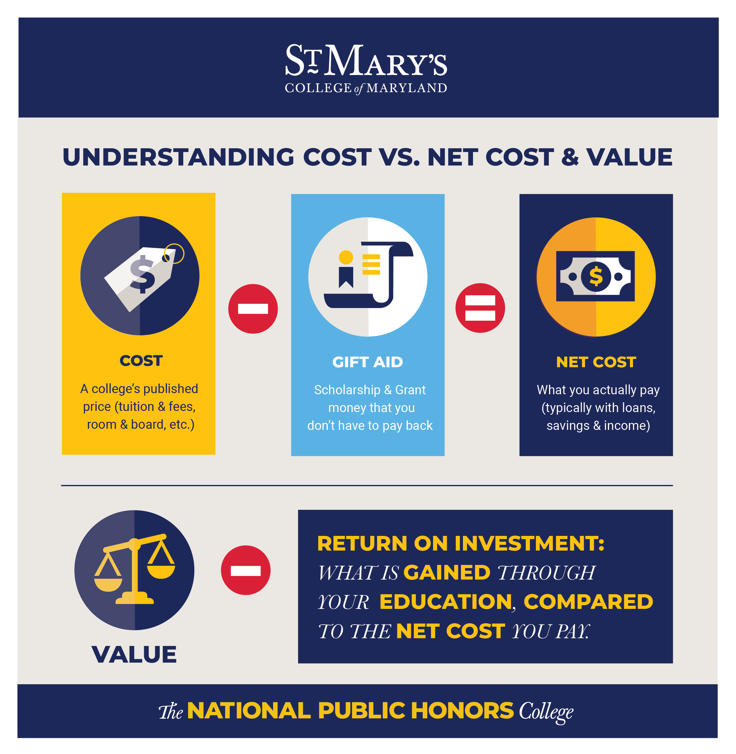

Slide 27
Tools You Can use
Federal Student Aid
  https://studentaid.gov
FAFSA4Caster
  Help to get an idea of EFC/Need
  “College Cost Worksheet”
Net Price Calculators (NPC)
  Every Title IV school is required to have one

Slide 28
Questions?

