Slide 1

An Introduction to the
Advanced Placement Program®
Col. Zadok Magruder High School
Mrs. Virginia Snyder, Academic Coordinator

Slide 2

Welcome
Magruder High School is committed to every student’s success.
We believe access to rigorous course work such as Advanced Placement® (AP®) plays an important role in that success.
Notes:
Presenter Notes:
Introduce myself.
Some of you may be familiar with our program and for many of you this will be new information. Our program continues to grow and evolve, so we hope you’ll find this information helpful.
This is your meeting so as we go through the information, please jot down your questions and I’ll stop periodically to answer them.

Slide 3
What We'll Cover
What are Advanced Placement® Courses?
The Benefits
AP® Exams
What Is It Like to Take AP?
Next Steps: Help Your Child Make the Best Choices
Q & A
Notes:
Presenter reviews agenda with attendees, makes sure everyone can see the screen, hear, etc.
Presenter asks for questions prior to launching the next part of the presentation.

Slide 4

What Are Advanced Placement® Courses?

Slide 5
Advanced Placement ®: The Basics
AP® courses are college-level courses offered in high school
Courses reflect what is taught in top introductory college courses
Students take AP Exams at the end of the course, measuring their mastery of college-level work
A score of 3 or higher on an AP Exam can typically earn students college credit and/or placement into advanced courses in college
Notes:
Presenter can add to this information with the following points:
Advanced Placement® is a program developed and overseen by the College Board, the not-for-profit organization that is responsible for the PSAT/NMSQT®, SAT®, and other programs and services in college readiness and college success that help more than seven million students each year prepare for a successful transition to college.

Slide 6
Our AP® Courses
Arts: Art History, Music Theory, Studio Art: Drawing Portfolio, Studio Art: 2-D Design Portfolio, Studio Art: 3-D Design Portfolio
English: English Language and Composition, English Literature and Composition
History and Social Sciences: European History, Human Geography, Macroeconomics, Microeconomics, Psychology, United States Government and Politics, United States History, World History
Mathematics and Computer Science: Calculus AB, Calculus BC, Computer Science A, Statistics
Sciences: Biology (double period), Chemistry (double period), Environmental Science, Physics C: Mechanics
World languages: French Language and Culture, Spanish Language and Culture, Spanish Literature and Culture
Notes:
Presenter will highlight courses in each content area
Mention that English Lang is 11th grade and English Literature is 12th grade

Slide 7
AP® at Magruder High School
779 AP exams were taken in May 2017 by 465 students.
703 students are enrolled in AP for the 2017-2018 school year.
This is a 20% increase from the 580 students enrolled in AP for the 2016-2017 school year.
MHS has a partnership with Equal Opportunity Schools (EOS) which is part of a MCPS and state initiative to ensure equal access to AP courses.
Offering 25 AP courses for 2018-2019
Notes:
Presenter can provide stats (if available) about the growth of the school’s AP program.
AP Scholars information [if needed]: https://apstudent.collegeboard.org/exploreap/the-rewards/scholar-awards

Slide 8

AP®: The Benefits

Slide 9

AP®: The Benefits
Students learn rigorous college-level content and skills
Taking AP is valued in the college admission process
AP courses are interesting and rewarding academic experiences
Opportunity to earn valuable credit and placement in college

Slide 10
AP® from the College Admissions Perspective
85% of selective colleges and universities report that a student’s AP experience favorably impacts admission decisions*
Colleges rank grades in college-preparatory courses and strength of curriculum as the two top factors in the admission decision
AP courses tell college admission officials that students are challenging themselves and preparing for the rigors they'll encounter in their college careers
*Unpublished institutional research, Crux Research Inc., March 2007
Notes:
Presenters are encouraged to include the AP® policies and statements of their own local and state universities where applicable to reinforce the importance of AP classes in the competitive college admission process.

Slide 11
AP®: Skills & Advantages that Last a Lifetime
Taking an AP course helps students build critical thinking skills, confidence, and the essential time management and study skills needed for college success
Nationally, research shows that students who score a 3 or higher on an AP Exam typically earn higher grade point averages in college and have higher graduation rates than their non-AP peers*
*2009, The College Board, “The Relationship Between AP Exam Performance and College Outcomes"

Slide 12
AP® Helps Students Graduate on Time & Save Money
Students who take AP courses and exams are much more likely to complete a college degree on time.* Graduating in four years represents a significant savings on the cost of college.
Only 1 in 4 college students completes a bachelor’s degree in 4 years.
The average cost of college for a single year is $23,410** for in-state schools (tuition, fees, room/board, misc. expenses).
*College Outcomes Comparisons by AP and Non-AP High School Experiences, The College Board, 2008
**The College Board, Trends in College Pricing 2014, Figure 1
Notes:
Presenter can add additional bullets on the college admission/college graduation rates at your school for former students in your AP courses.

Slide 13

AP® Expands Students’ Options
When students earn college credit through AP Exams, their options and opportunities expand:
Move to upper-level college courses sooner
Pursue a double major
Gain time to study and travel abroad
Graduate early

Slide 14
AP®: A More Engaging Learning Experience
AP courses challenge students to work and participate at a higher level:
Opportunities to explore topics in depth
More time in and out of the classroom required to complete assignments and projects
High expectations for critical thinking, analysis, synthesis, evidence, multiple perspectives, and clear written and verbal communications

Slide 15

AP® Exams

Slide 16

AP® Exams
AP Exams are administered by schools worldwide on set dates in May each year.
Exams are typically 2–3 hours and include:
  Multiple-choice questions
  Free-response items such as essays, problem solving,
  document-based questions and oral response

Slide 17
AP® Exam Fees
The exam fee for 2017 is $94 per exam.
Assistance is available for eligible students with financial need:
  The College Board offers a $32 fee reduction per exam for eligible students with financial need.
  MCPS offered an additional fee reduction for 2017 resulting in students qualifying for financial need paying $20 per exam.
Notes:
Important to plan ahead for exam costs, especially for students that are taking multiple AP exams.

Slide 18
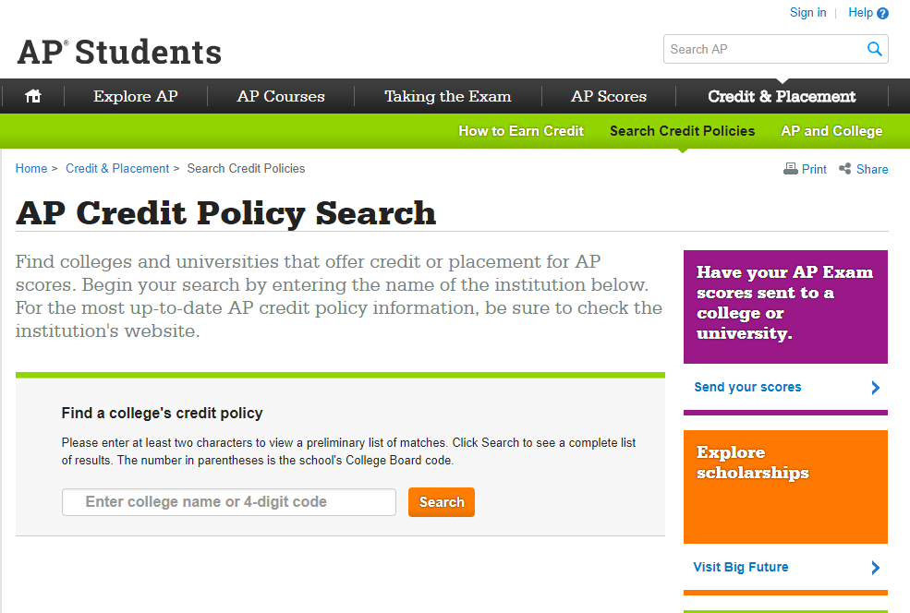
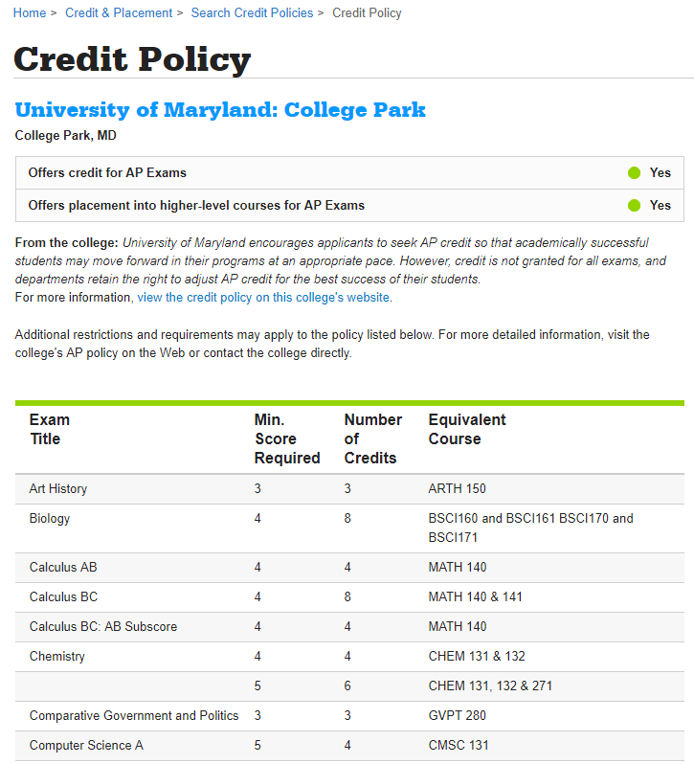
Credit and Placement Opportunities
Each college and university has its own policies regarding AP® credit and placement. The College Board offers information about AP credit at thousands of college and universities at www.collegeboard.org/apcreditpolicy.
Search by school name or code
Data for each school includes a direct link to that school’s Web page detailing AP credit and placement policies
A statement from the college or university about its AP policy
Notes:
Mention that a 3 credit course at MC is roughly $470 dollars.

Slide 19
What is it like to take AP®?

Slide 20
AP® Myths & Realities
Myth | Reality
AP courses are for students who always get good grades. | AP courses are for any students who are academically prepared and motivated to take college-level courses.
AP courses are too stressful. | It's no secret that AP courses are challenging. But the support you receive from your classmates and teachers can help you manage the work load.
I don't think I will score high enough on the AP Exam to get college credit. | You don’t need to score a 5. Many colleges grant credit — and placement as well — based on a 3 or higher on an AP Exam.
Taking AP courses could hurt my GPA. | Taking AP courses shows colleges that you’re willing to challenge yourself academically. Students do receive an extra point in their weighted GPA.
I can’t take AP because no one has recommended me. | If you think you’re ready to take an AP course, then you’re ready to advocate for yourself — just talk to a teacher or counselor.
Notes:
Presenter: This is a good time to address any other “myths” or misperceptions that you hear from your students about the AP program.

Slide 21
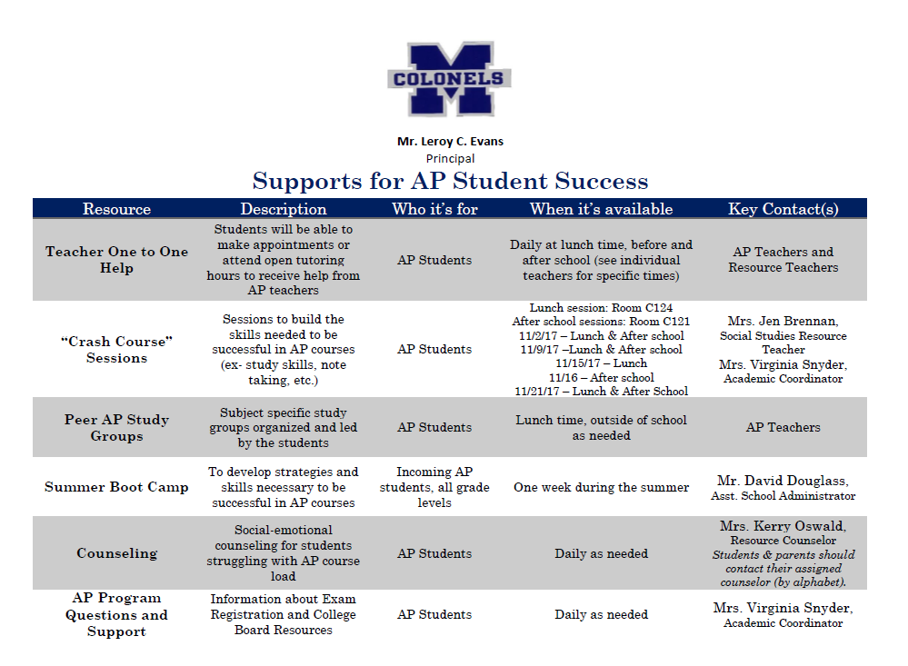
Our School Offers Support for AP® Students

Slide 22
Students & Parents … In Their Own Words
<Note: This is an optional section for your presentation. You can include one or more videos from The College Board YouTube Channel at www.youtube.com/advancedplacement featuring students and teachers talking about AP® choices and experiences.>
An AP teacher talks about her high expectations for her students
AP Program: Turning Curiosity into a Science
Karl describes AP classes as a glimpse into what college is like
The Value of AP for Latino Students (in Spanish)
Teachers recognize AP student achievements
AP Program: Creativity Makes A Mark

Slide 23


College Admissions Officials In Their Own Words
AP Program: The impact of AP credit and placement on the college experience

Slide 24
Next Steps: Help Your Child
Make the Best Choices

Slide 25
AP®: Start the Conversation
Help your child prepare to talk to a teacher or counselor about AP. Here are some questions to encourage your child to think about:
What AP course is right for me?
Before you talk to a teacher or counselor, think about what interests you:
Which courses do you enjoy most in school? In which subjects do you excel?
What college majors are you considering? What careers excite you?
Ask your counselor or teacher the following questions:
In which AP courses at our school am I likely to do well?
Are there other courses that can help me succeed in AP or prepare me for college and careers?
What steps do I need to take?
What is our school’s enrollment deadline?
May I speak with a student who has taken an AP course?
Are there study groups or people who can offer help if I need it?
What can I do next to help me prepare for AP?
Notes:
Presenter: Encourage families to talk openly and realistically with students about the time commitment, challenges, etc., without exaggerating the difficulties. Many students take multiple AP courses and thrive. Others find better success with one or two AP courses, depending on their other school, work and home commitments.

Slide 26
AP®: Resources Worth Exploring for Students and Families
AP information: apstudent.collegeboard.org
College and Career Planning: bigfuture.org
Personalized feedback, practice and college planning based on your PSAT/NMSQT® results: My College QuickStart™ www.collegeboard.org/quickstart
AP credit policy information from colleges and universities: www.collegeboard.org/apcreditpolicy
Notes:
Presenter: Encourage families to explore these resources on their own and with their children as they’re researching college opportunities and options.

Slide 27

Explore AP®: Take the Next Step
Notes:
Presenter: Now presenter asks for questions and discussions.

Slide 28
Questions and Answers

Slide 29
AP Exam Registration
If your student is currently enrolled in an AP class, the deadline to register for May 2018 exams is Wednesday, January 31, 2018.
You can register tonight!

Slide 30
Enjoy the fair!

