Slide 1


Naviance Course Planner

Slide 2
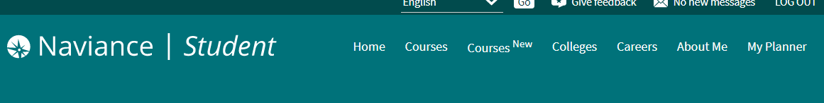
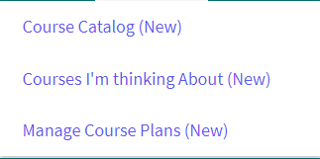
New Course Planner Tools
Naviance
Log into your Naviance Student account.
Look at the top of the screen at the tabs.
Notice the Course NEW (this is new!)
Click on the Courses NEW tab and review the options.
Click on Manage Course Plans (new)
Manage Course Plans is where you will create your four-year academic plan and adjust each school year.

Slide 3
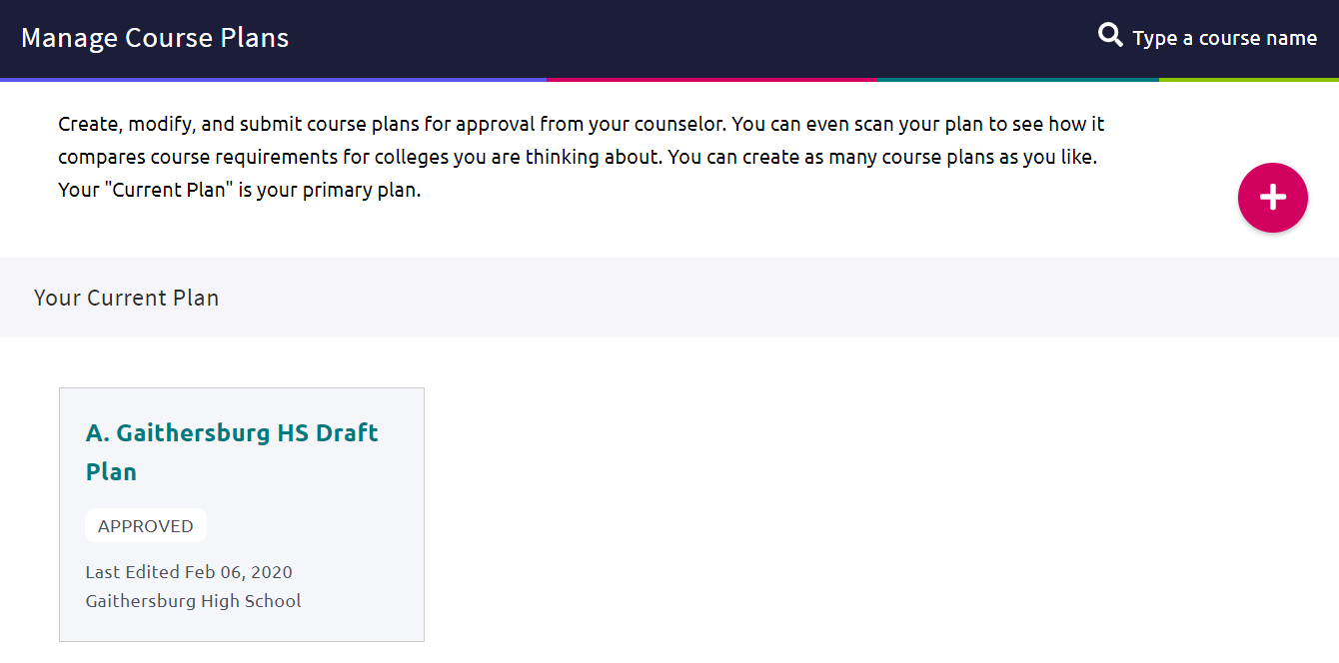
New Course Planner Tools
Naviance
Below you will see any plans you have previously created. If you have not created a plan before this section will be blank.

Slide 4
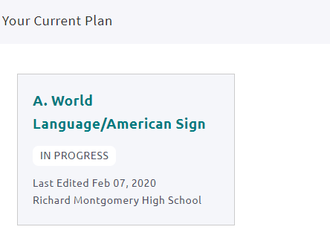
If you have already created a plan, click on that plan to continue…..

Slide 5
If you do not have a plan, please create one now by clicking on the + sign….

Slide 6
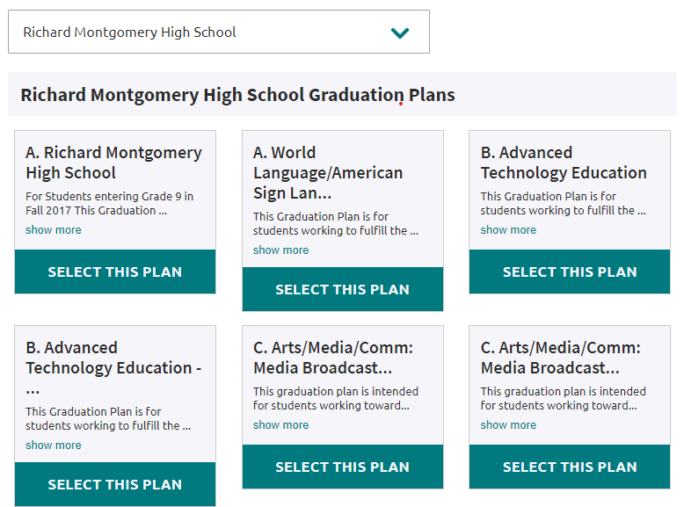
Once you click on the button to begin a new plan, you will come to this screen. From the list below please select the World Language/American Sign Language Template….

Slide 7
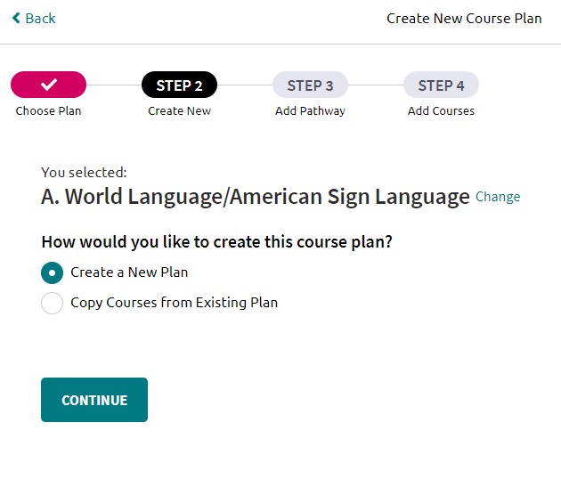
The 2nd step to create a new plan is to Select the “Create a New Plan” button and click Continue

Slide 8
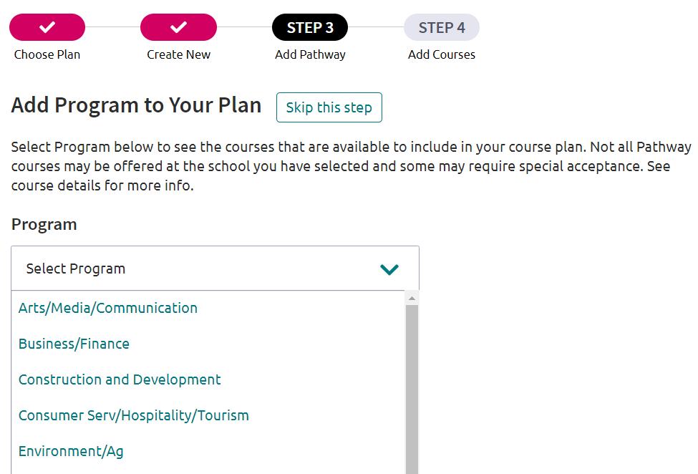
ON the next page click on “Skip this step”…

Slide 9
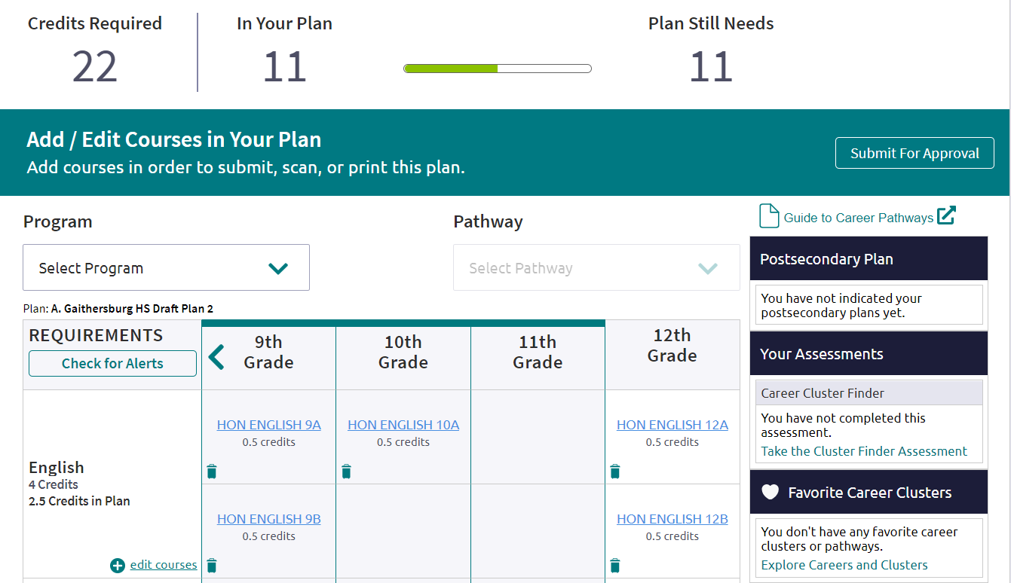
You are now ready to add new courses to your plan…
Students can add or edit courses by clicking on the “edit courses” button next to each subject area.

Slide 10
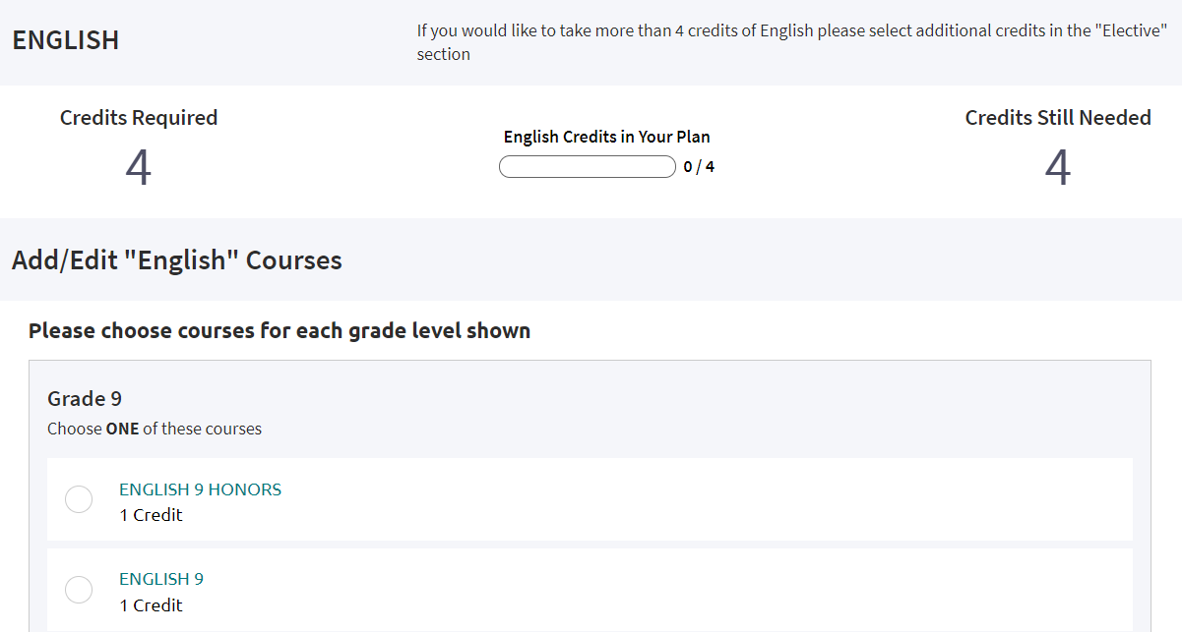
New Course Planner Tools
Naviance
Scroll through the course options and make your selections by grade level.
Once completed, scroll to the bottom of the page and click the “Add Courses to Your Plan” button.

Slide 11
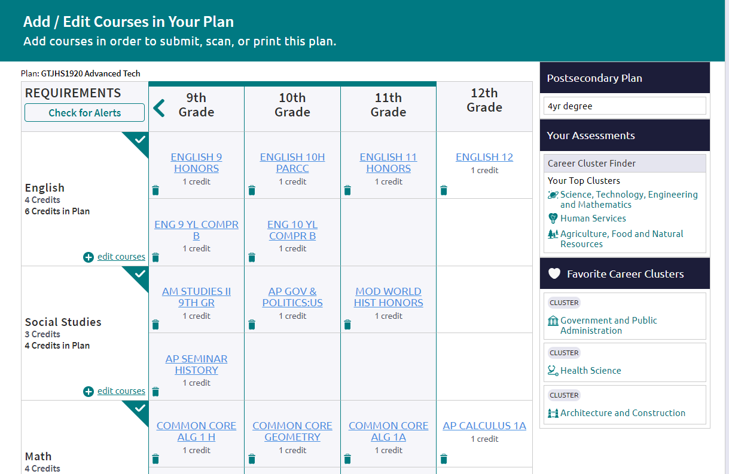
New Course Planner Tools
Naviance
Repeat the steps for each of the subject areas until you have completed your academic plan.
Review your plan and keep track of the number of credits you have selected.
Double check your plan for any gaps.

